Slide 1






Improvising inventory management system (visual computing)

Slide 2
TEAM :
USN NUMBER | NAME | DEPARTMENT
1RV23CS166 | PIYUSH KHERIA | CSE
1RV23IS088 | PRARTHANA HIMANSHU UPADHYAYA | ISE
1RV23EC128 | SALONI JHADAV | ECE
1RV23EI009 | ARNAV SINGHAL | EIE

Slide 3

LIST OF CONTENTS
Introduction
Problem Statement
Literature Review
Methodology
Outcome
Challenges

Slide 4

INTRODUCTION Our goal is to improve inventory management and prevent internal theft using advanced surveillance and image processing. We aim to track inventory accurately and spot human errors in restocking. This solution saves businesses money and time while making inventory management easier and more reliable. Existing Inventory Management system
Ineffective operation - manual processes slow down order fulfilment and increases labor cost
Limited visibility - Traditional software often lack the ability to track inventory in real-time accurate
Data: Manual processes for data entry and recordkeeping are prone to human error. Inaccurate data leads to discrepancies between what's recorded in the system and the actual stock on hand.
Cybersecurity Vulnerabilities: With the rise of e-commerce and connected warehouses, inventory management systems are increasingly vulnerable to cyberattacks.

Slide 5

PROBLEM STATEMENT
Losses due to human errors in restocking and internal theft, or due to discrepancies in maintaining records. Blind spots in warehouse, security concerns, human labour and number of hours of redundant work.

Slide 6
Addressing Inventory Loss
Employee Theft
Administrative Errors
Damage and Theft
Employee theft is a substantial contributor to overall shrinkage, responsible for 30-40% of losses according to the National Retail Federation's 2022 National Retail Security Survey. Our system's real-time visibility and tracking capabilities can help mitigate this issue, while also fostering a culture of trust and accountability among warehouse workers.
Miscounts, misplaced items, and faulty record-keeping can lead to significant discrepancies, contributing up to 20% of total shrinkage. By integrating a robust Warehouse Management System (WMS) with our computing visualisation, we can significantly reduce these errors, ensuring accurate inventory management and minimising delays.
Accidental damage during handling, storage, or transportation, as well as shoplifting, can also contribute to inventory loss. Our system's real-time monitoring and optimised workflows can help mitigate these issues, while also enhancing overall warehouse security and efficiency.

Slide 7




The Future of Warehouse Operations
Increased Efficiency
Improved Accuracy
Human-Machine Collaboration
Transformative Impact
By seamlessly integrating computing visualisation with inventory management, we can unlock a new level of efficiency in warehouse operations, optimising workflows and reducing the burden of manual labor.
Our system's real-time tracking and data-driven decision-making can significantly enhance inventory accuracy, minimising discrepancies and ensuring the right products are available at the right time.
The integration of computing visualisation and warehouse robots fosters a collaborative approach, where human workers and machines work in harmony to optimise operations and drive innovation.
Our solution represents a paradigm shift in inventory management, redefining the role of technology in warehouse operations and paving the way for a more efficient, accurate, and future-ready supply chain.

Slide 8

Leading Logistics Providers in India
AAJ Enterprises
Mahindra Logistics
Quickshift
AAJ Enterprises, a logistics company dedicated to serving small and growing businesses in India, has showcased its state-of-the-art warehouse and fulfilment process. Their facility in Haryana boasts advanced technology, efficient processes, and a commitment to excellence, setting a new standard for warehouse operations.
Mahindra Logistics offers robust warehousing and distribution solutions, including storage space management, order fulfilment, inventory management, and pick-and-pack services. Their integrated approach ensures secure product storage and prompt distribution, enhancing overall operational efficiency.
Quickshift is a leading e-commerce fulfilment partner, offering end-to-end order management services. Their Warehouse Management System (WMS) is designed to optimise inventory levels, warehouse space utilisation, and product movement tracking, ensuring accurate inventory management and swift product distribution.

Slide 9



METHODOLOGY
BUILDING THE STRUCTURE AND PLANNING FOR WEBSITE
CODING FOR THE WEBSITE FRONTEND
SURVEY
BACKEND AND INTEGRATED SYSTEM
VISUAL COMPTUTING ALGO

Slide 10







Tools used
Image Processing Libraries (OpenCV - Python)
Surveillance – (YOLO 5.0 algorithm- (you only look once))
Data analytics tools – (Pandas (python))
Relational Database Management System (MongoDB, SQL)
UI-UX – (Tailwind CSS)
Frontend – (React.js)
Backend – (php)

Slide 11
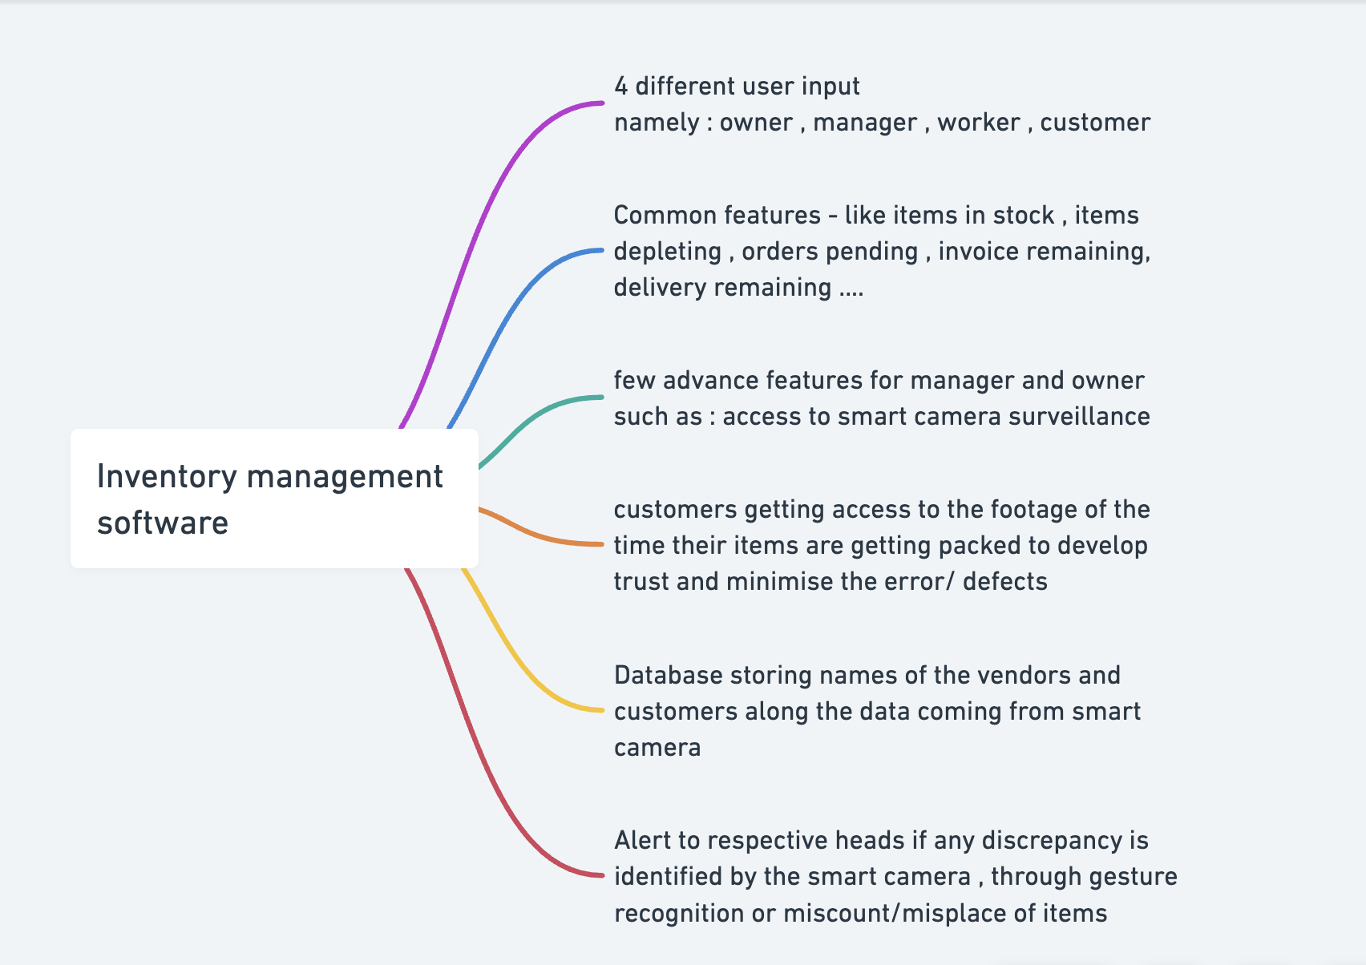

Slide 12
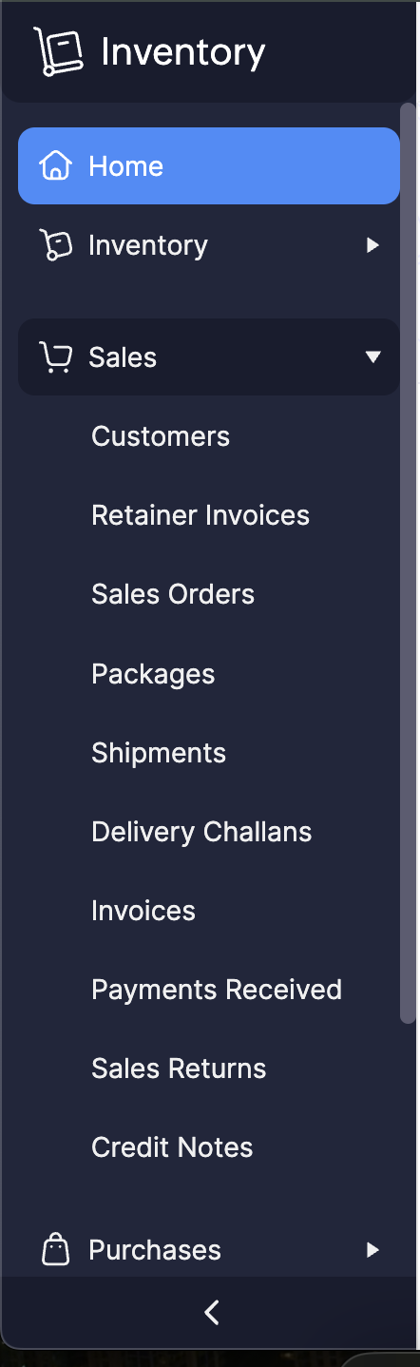
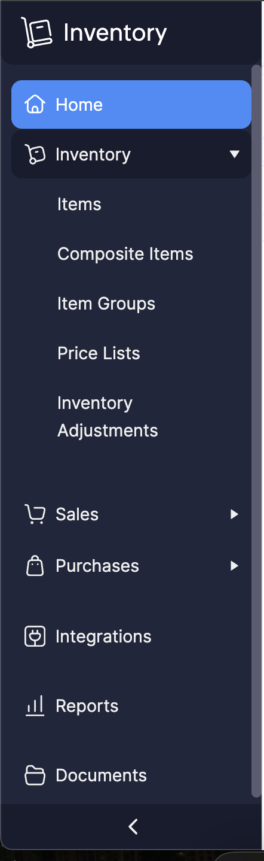
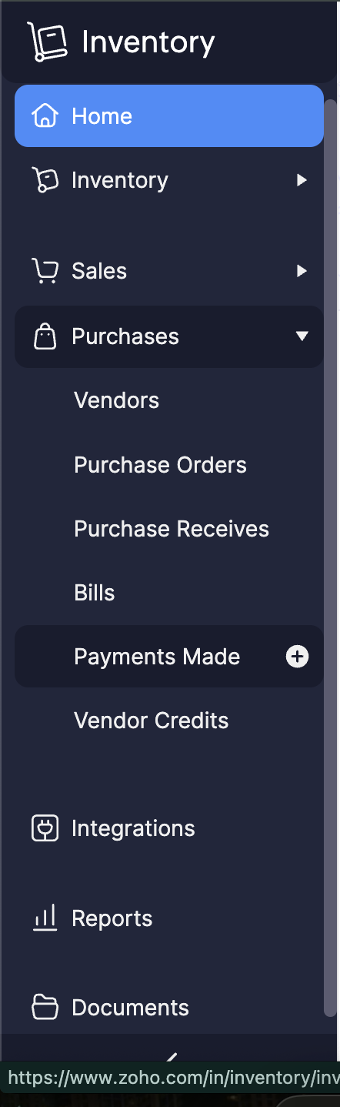

Slide 13
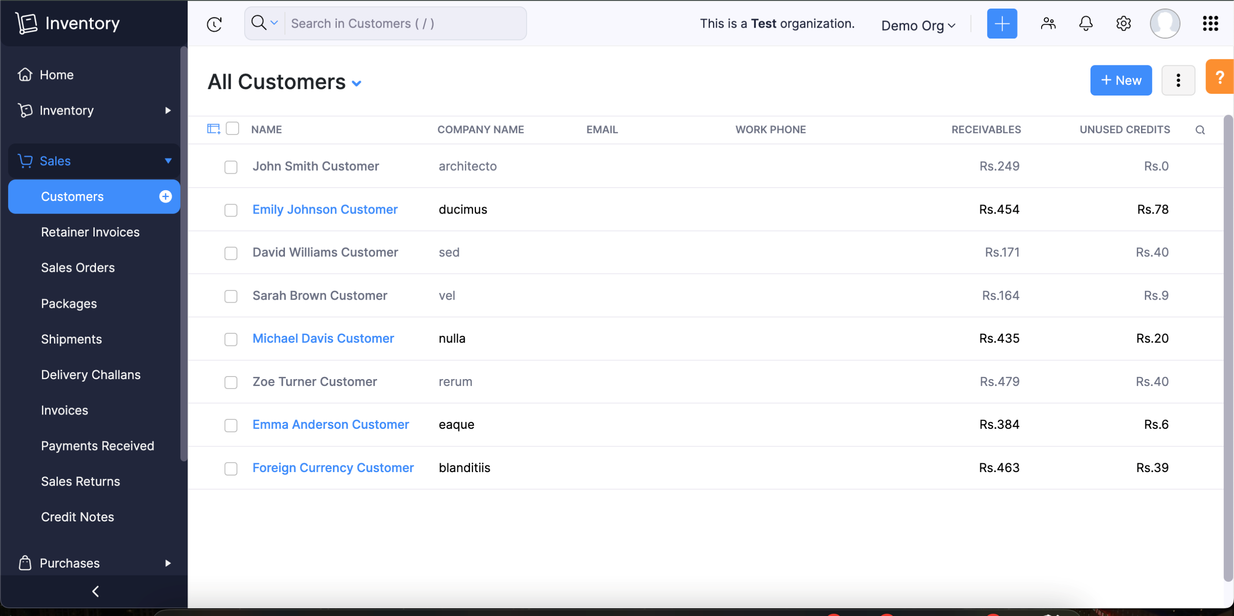

Slide 14
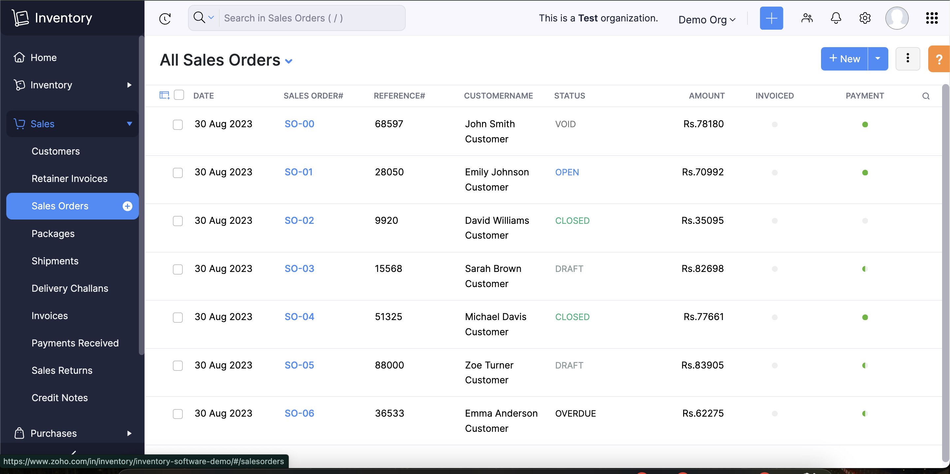

Slide 15
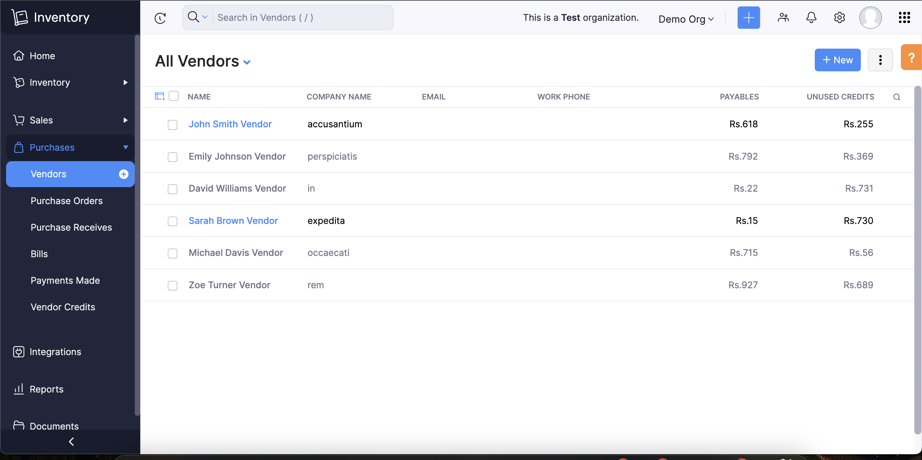

Slide 16
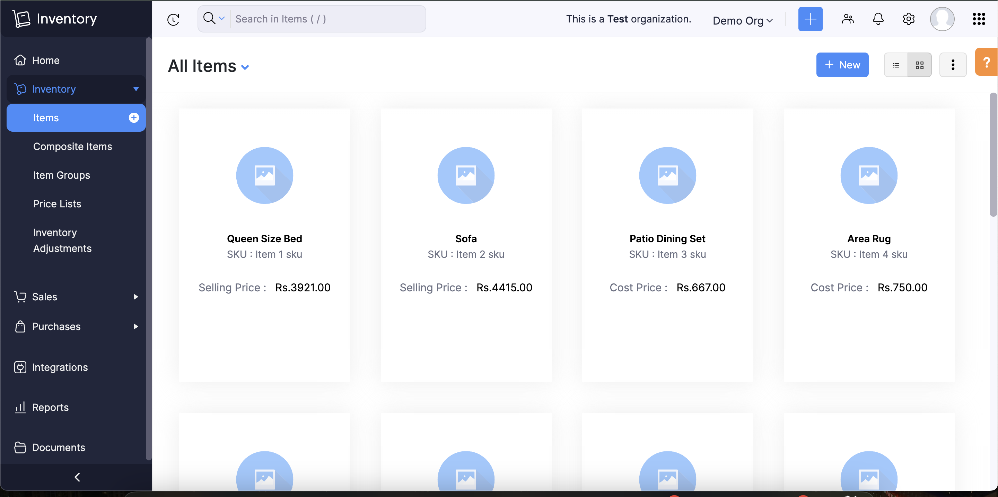

Slide 17
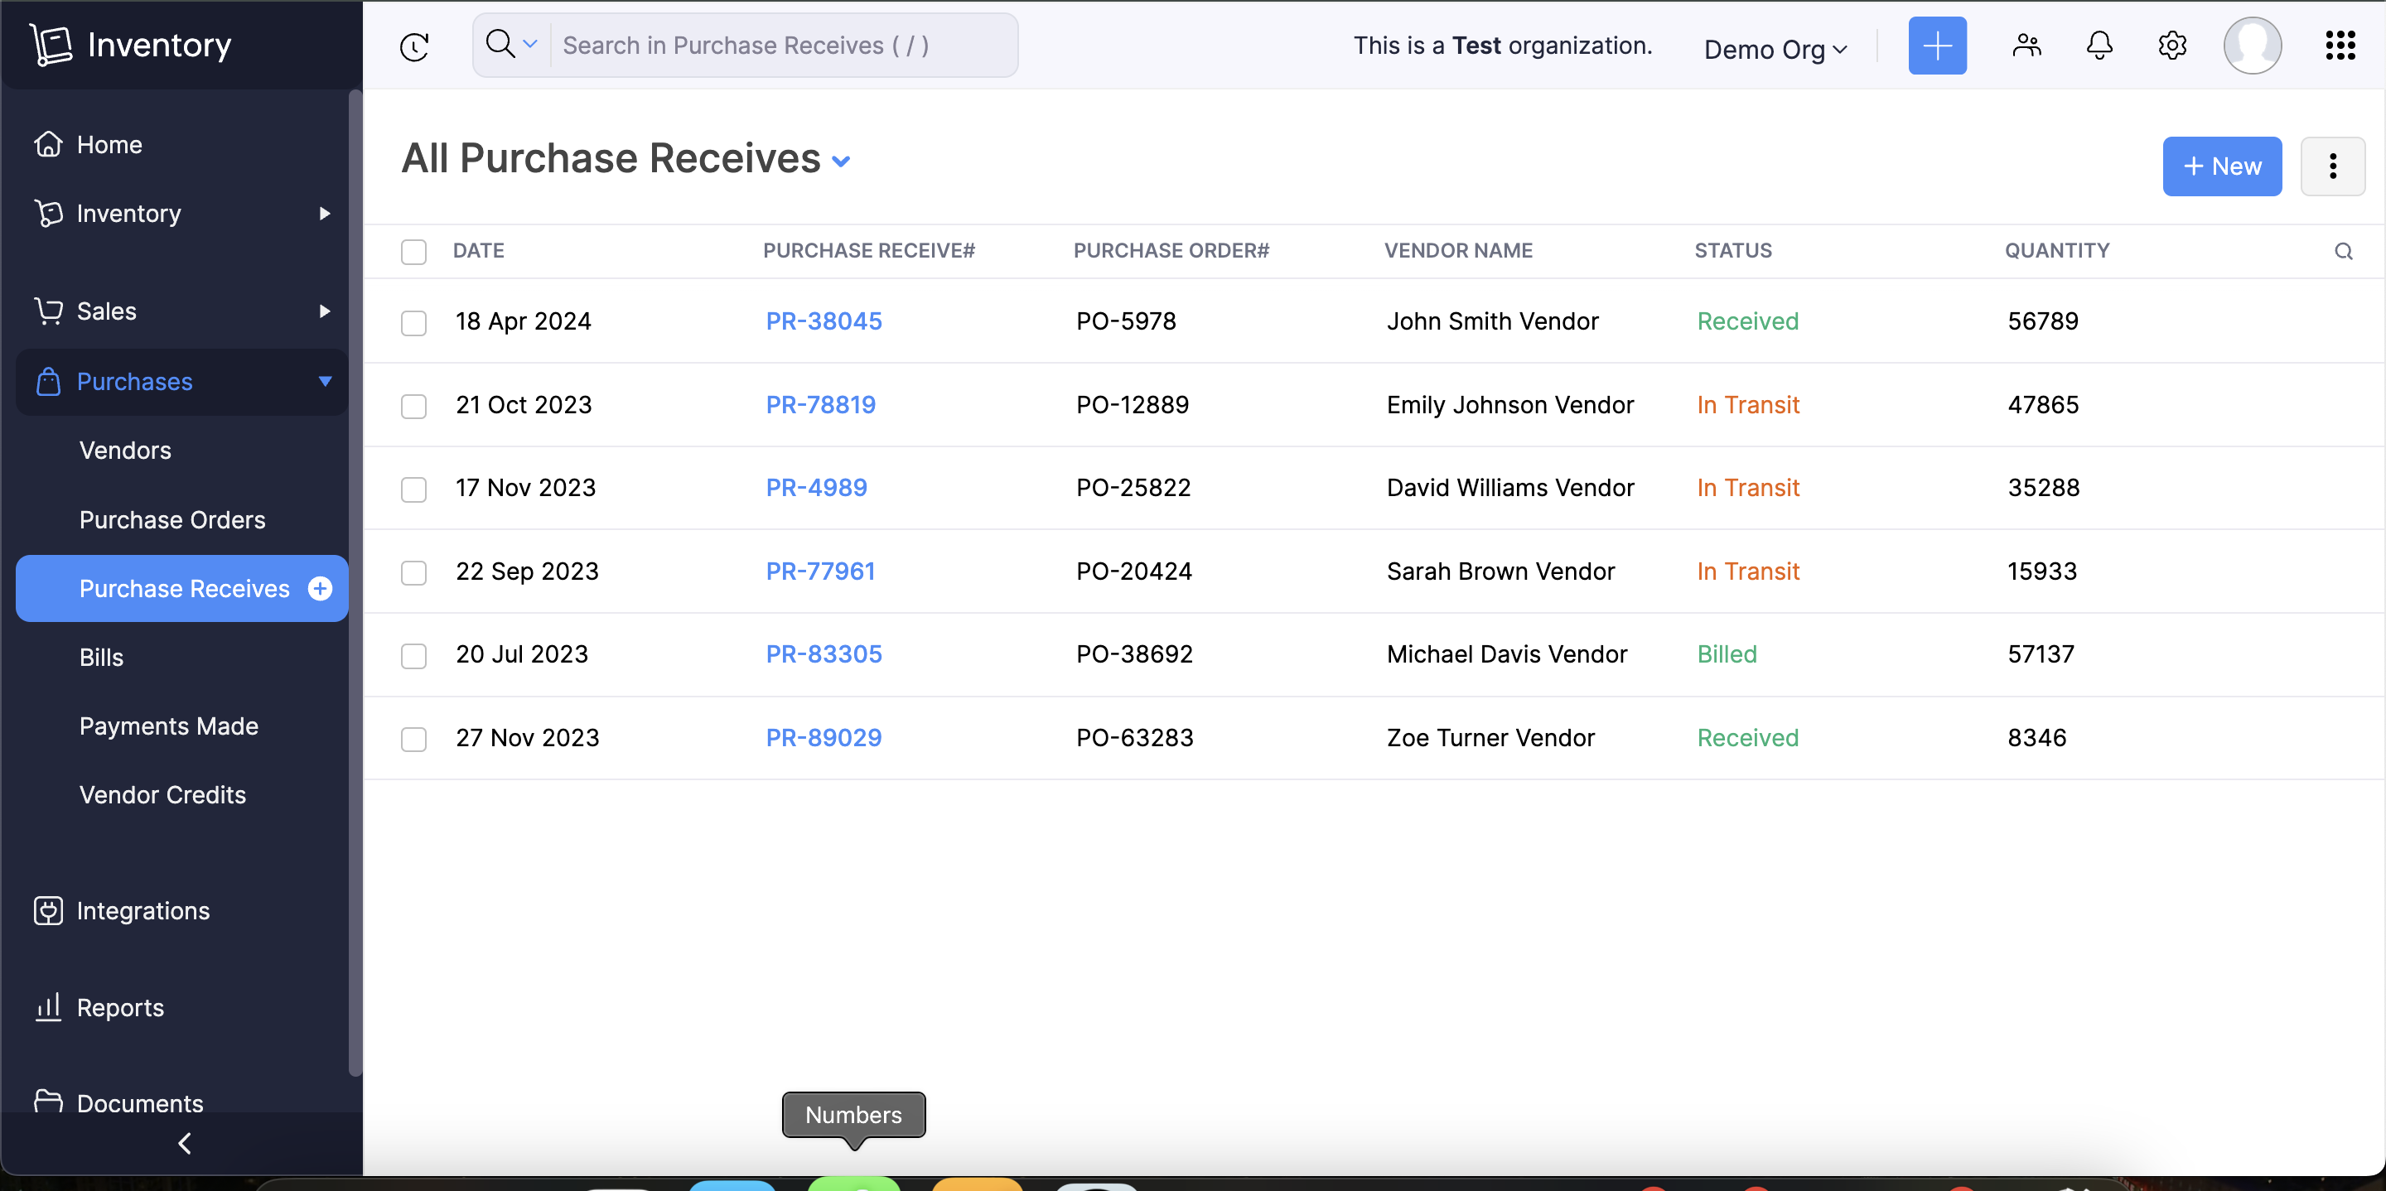

Slide 18
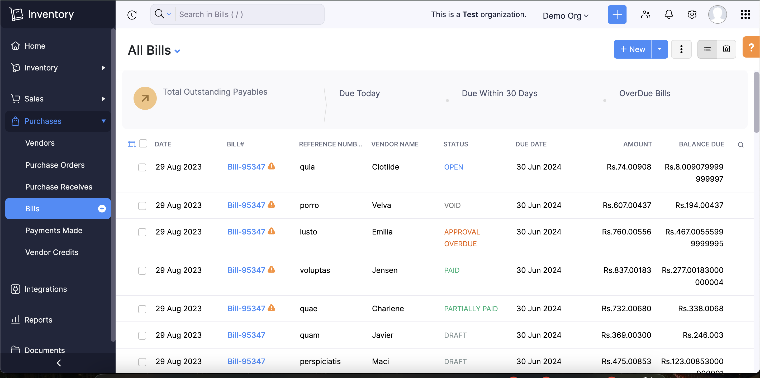

Slide 19
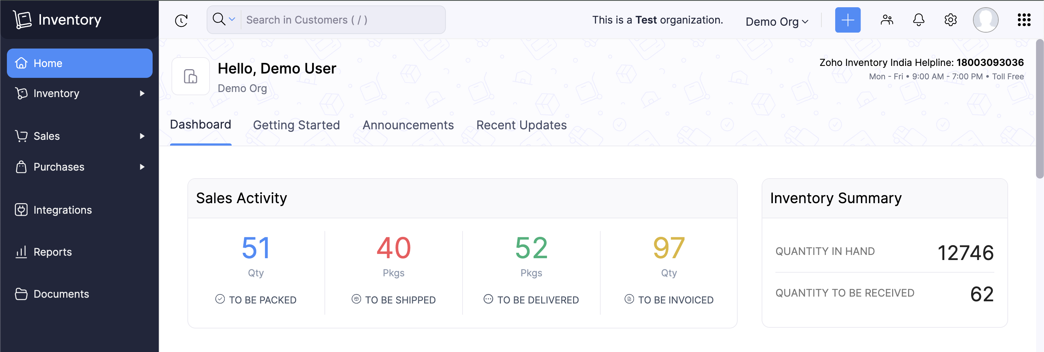

Slide 20
CHALLENGES
Ensuring consistent access to the camera and capturing high quality images for visual computing
Finding a training set while maintaining high detection accuracy under different lighting conditions, angles, and distances
Efficiently integrating scanned data object detection results with the inventory management database while ensuring data consistency and performance
Creating a labelled dataset for training and validating object detection models, time consuming and requires accuracy
Identifying and resolving issues during testing, especially for complex tasks like object detection and database integration
Bringing non-technical members up to speed with necessary skills like basic Python, SQL, and computer vision concepts

Slide 21
FUTURE SCOPE
Decentralisation of inventory tracking by integrating blockchain concepts.
Smart Contract – Driven Automated Reordering and Tokenisation of inventory items.
AI powered Inventory Optimisation – Use machine learning algorithms to analyse historical sales data, predict future demand, and optimise inventory levels.
Use AR technology to provide warehouse staff with real-time, visual inventory information through AR glasses or mobile devices.
Use IoT devices (eg, RFID tags, smart shelves) to provide real-time visibility into inventory status and location.

Slide 22
THANK
YOU

